Slide 1
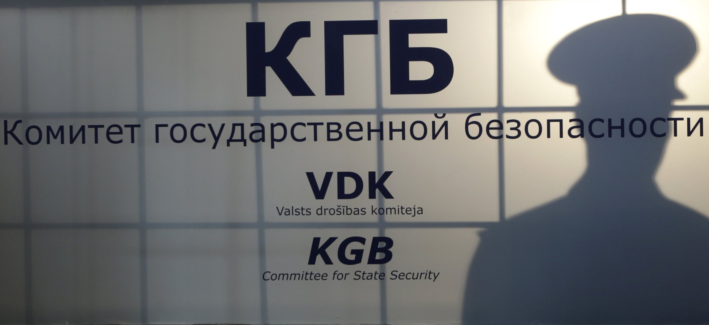
Double Spy Game
  West Berlin – January, 1957

Slide 2
протокол:
Retrieve your packet
Examine the contents
Follow the instructions
Develop a new Team name.
Develop new Spy Names

Slide 3
задача:
Writing Rubric
  Grammar & Readability – 15 Points
    Proper grammar – 15 Points
    A few errors – 10 Points
    Unreadable – 0 points
  Summarizations – 25 Points
    All 5 Documents Summarized – 25 Points
    3 Documents Summarized – 15 Points
    >2 Documents Summarized – 0 Points
  Historical Relevance – 30 Points
    3 Points of Historical Relevance – 30 Points
    2 Points of Historical Relevance – 20 Points
    1 Point of Historical Relevance – 1 Point
    0 Points of Historical Relevance – 0 Points
  Why It Is Important – 30 Points
    3 Points of Importance – 30 Points
    2 Points of Importance – 20 Points
    1 Point of Importance – 10 Points
    0 Points of Importance – 0 Points
Email the completed Document to tgragg@mid-del.net

