Slide 1
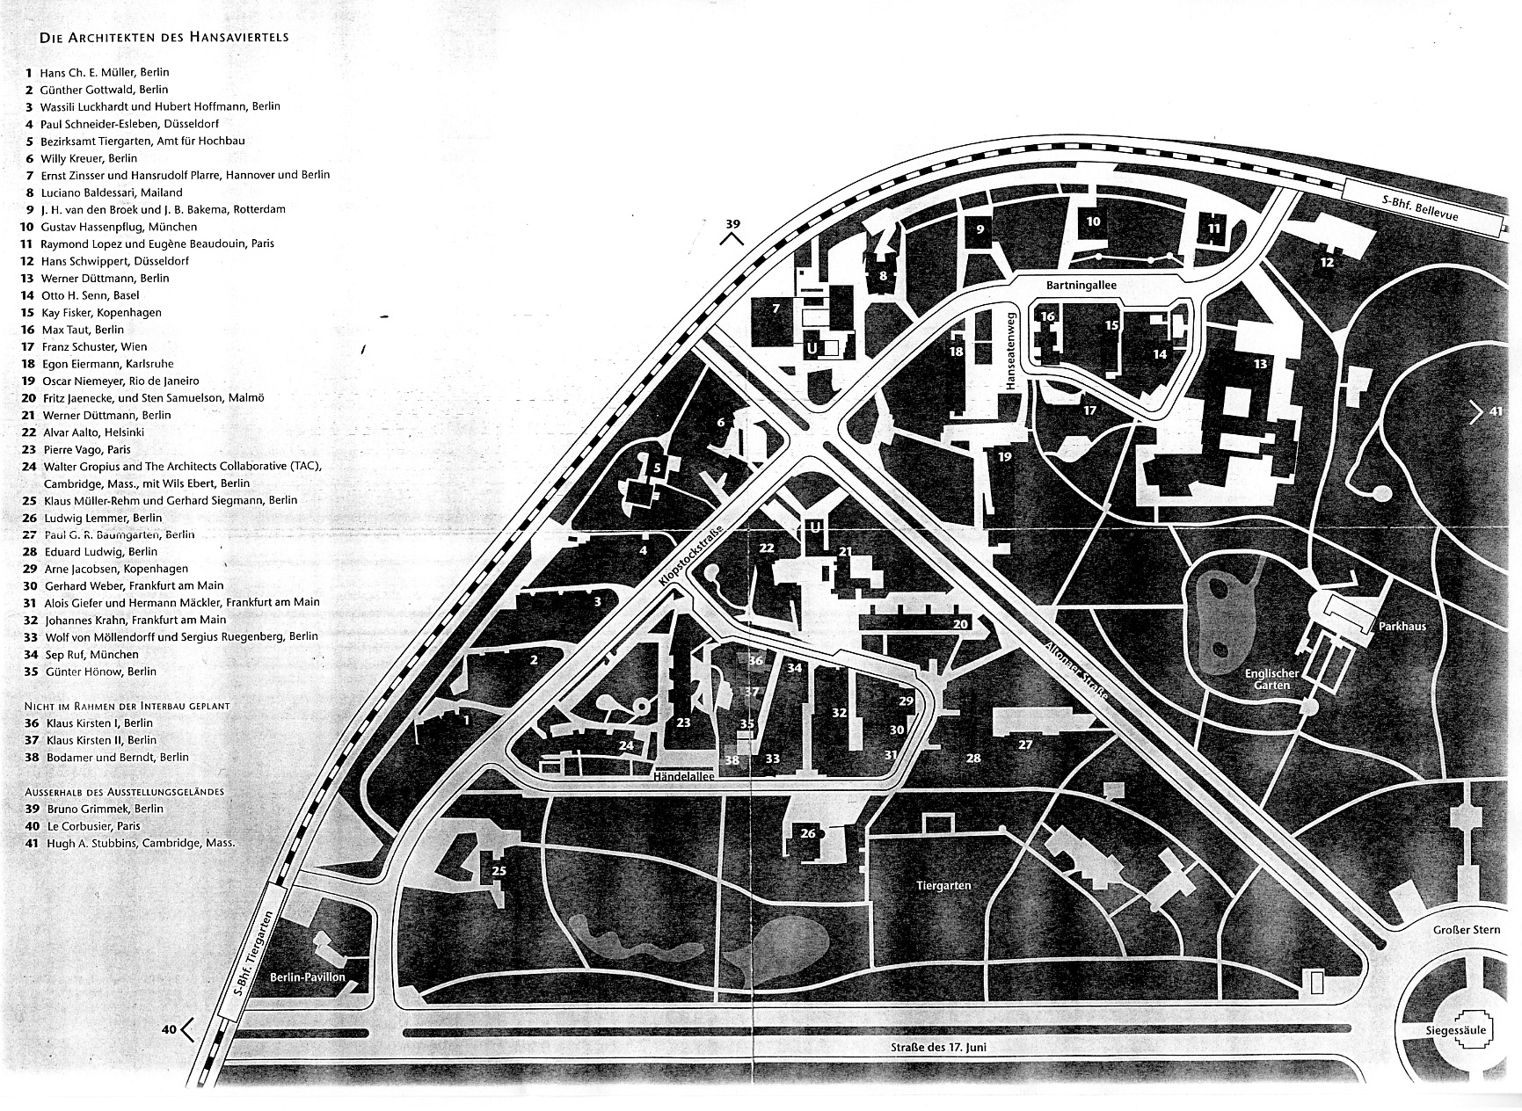
Double Spy Game
  East Berlin – January, 1957

Slide 2
протокол:
Retrieve your packet
Examine the contents
Gather with your team

Slide 3
задача:
Prepare the document to give to Comrade Rodoyf
Prepare a Presentation to Be Delivered to Comrade Rodoyf

