Slide 1
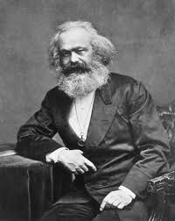
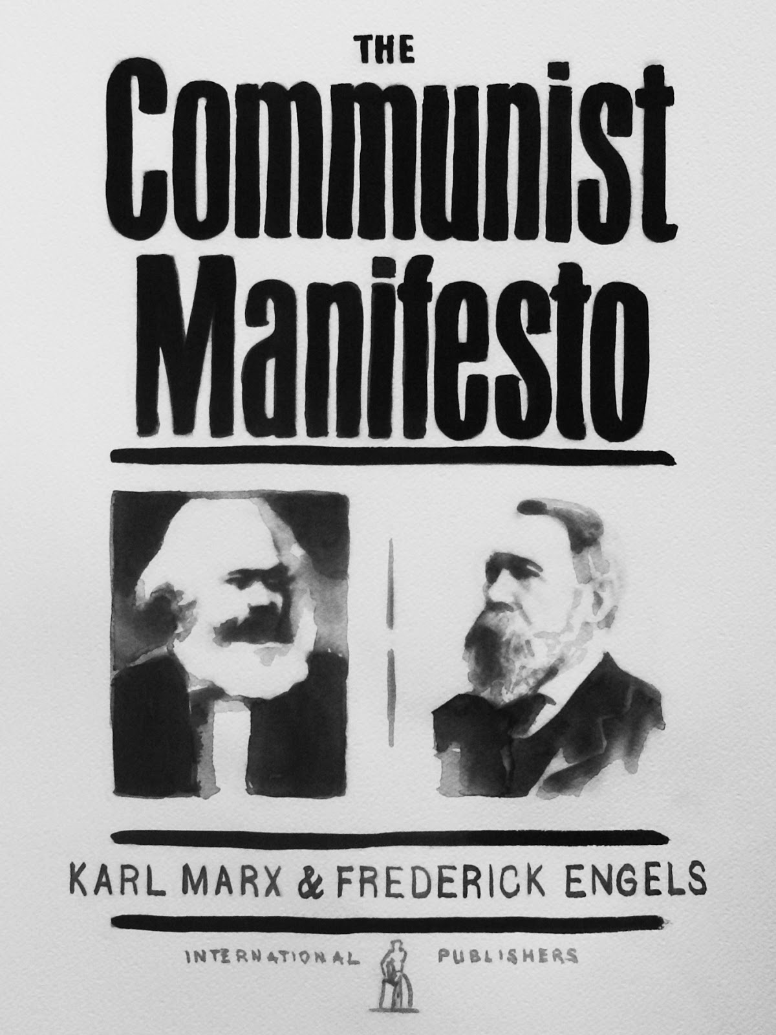
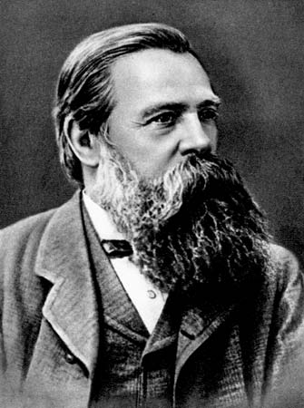
Karl Marx & Friedrich Engels Publish
The Communist Manifesto – 1848

Slide 2
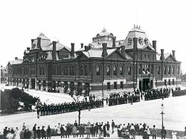
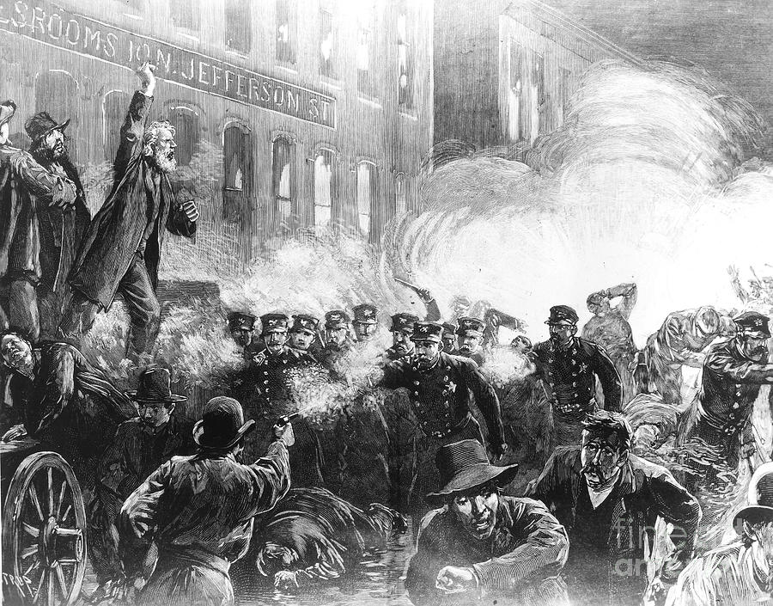
Chicago Labor Movement
McCormick Reaper Works Riot – May 03, 1886
Haymarket – May 04, 1886
Pullman Strike – 1894

Slide 3
The 1917 Russian Revolution
The Romanov’s
Tsar Nicholas (1868-1918)
  Ruled 1894-1917.
  Cared more for family than state matters.
  Disregarded the plight of his people.
Tsarina Alexandra
Son – Alexei
Daughters
  Olga
  Tatiana
  Maria
  Anastasia

Slide 4
The 1917 Russian Revolution
The Background
Wars
  Crimean War – 1854-1856
  Russo-Turkish War – 1877-1878
  Russo-Japanese War – 1904-1905
  World War I – 1914-198
Results & Consequences of the Wars
  Russia defeated in all except Russo-Turkish War
  High Taxes
  High Loss Of Life
  Great discontent as economy and government suffered.

Slide 5
The 1917 Russian Revolution
The Background
Factors
  Population Boom
    1867-1896.
    Added 30 million people in 30 years.
    Almost all to the peasant class.
  Parties to the ground of the revolution.
    Peasant Class
      Experienced famine between the harvests
      Much suffering.

Slide 6
The 1917 Russian Revolution
The Background
Factors – continued
  Parties to the ground of the revolution - continued
    Industrial Working Class
      Low Wages.
      Poor Housing.
      Many work related accidents.
    Tsar Nicholas
      Lacked concern for the people.
      Was blamed for the Russo-Japanese War.

Slide 7
The 1917 Russian Revolution
The Background
Factors – continued
  The people were ready to revolt, they just needed a leader.
  That leader came in the form of Vladimir Lenin.
  Tsar Nicholas disbanded the Duma (Parliament) in 1915.
    The Duma had demanded a more representational and democratic form of government.
    Nicholas however was obsessed with retaining his privileges believing he was chosen by God to rule.
  The Tsar went to join the troops at war after this.

Slide 8
The 1917 Russian Revolution
The Background
Factors – continued
  Tsarina Alexandra was then running the country along with Grigori Rasputin.
    Rasputin was a Siberian peasant turned preacher.
    Followed a form of the Russian Orthodox faith that combined sexual orgies with faith healing.
    Rasputin had influence over the Tsarina because he cured Alexei
  Many leaders felt Rasputin’s influence was too great.
  Rasputin was assassinated December 30, 1916.

Slide 9
The 1917 Russian Revolution
The Revolution
March 08, 1917 riots started in Petrograd (St. Petersburg) – Bread Riots.
  Began with women demanding more bread.
  Spread to other industries throughout the city.
  Eventually the soldiers joined the riots.
On March 12, 1917 The Duma established a provisional government.
A few days later Nicholas abdicated the throne.
Alexander Kerensky became the leader of the provisional government.

Slide 10
The 1917 Russian Revolution
The Revolution
The provisional government established a liberal program granting freedom, equality, and rights.
They had to compete with Petrograd Soviet of Workers’ and Soldier’s Deputies’.
Petrograd Soviet of Workers’ and Soldier’s Deputies’ led the collapse of army discipline.
The provisional government failed to successfully deal with the food shortage.
Anarchy ruled the day.

Slide 11
The 1917 Russian Revolution
The Revolution
The Bolshevik’s attempted to seize power in July 1917 but failed.
Vladimir Lenin fled Petrograd and went into hiding in Finland.
  Vladimir Lenin – 1870-1924.
  Marxian Socialist.
In September 1917 through the power of the Bolshevik’s Leon Trotsky was elected Chairman of the provisional government.

Slide 12
The 1917 Russian Revolution
The Revolution
Lenin urged the Bolshevik’s to lead an armed uprising.
On November 06, 1917 Trotsky led the Bolshevik Revolution.
They stormed Petrograd and seized government buildings.
Declared Lenin as their new leader.

Slide 13
The 1917 Russian Revolution
The Revolution
Opposition to Lenin and the Bolshevik’s remained and increased.
Civil War broke out in 1918.
The Tsarist family had been imprisoned at the Alexander Palace in Tsarkoe Selo (Pushkin)
They were then transferred to a Bolshevik base in Yekaterinburg.
Were murdered there on July 16-17 1918.
Were murdered to prevent them from leading the anti-Bolshevism movement.

Slide 14
The 1917 Russian Revolution
The Revolution
In 1920 stability returned.
Russia emerged a much different country than it had been in 1916.

Slide 15
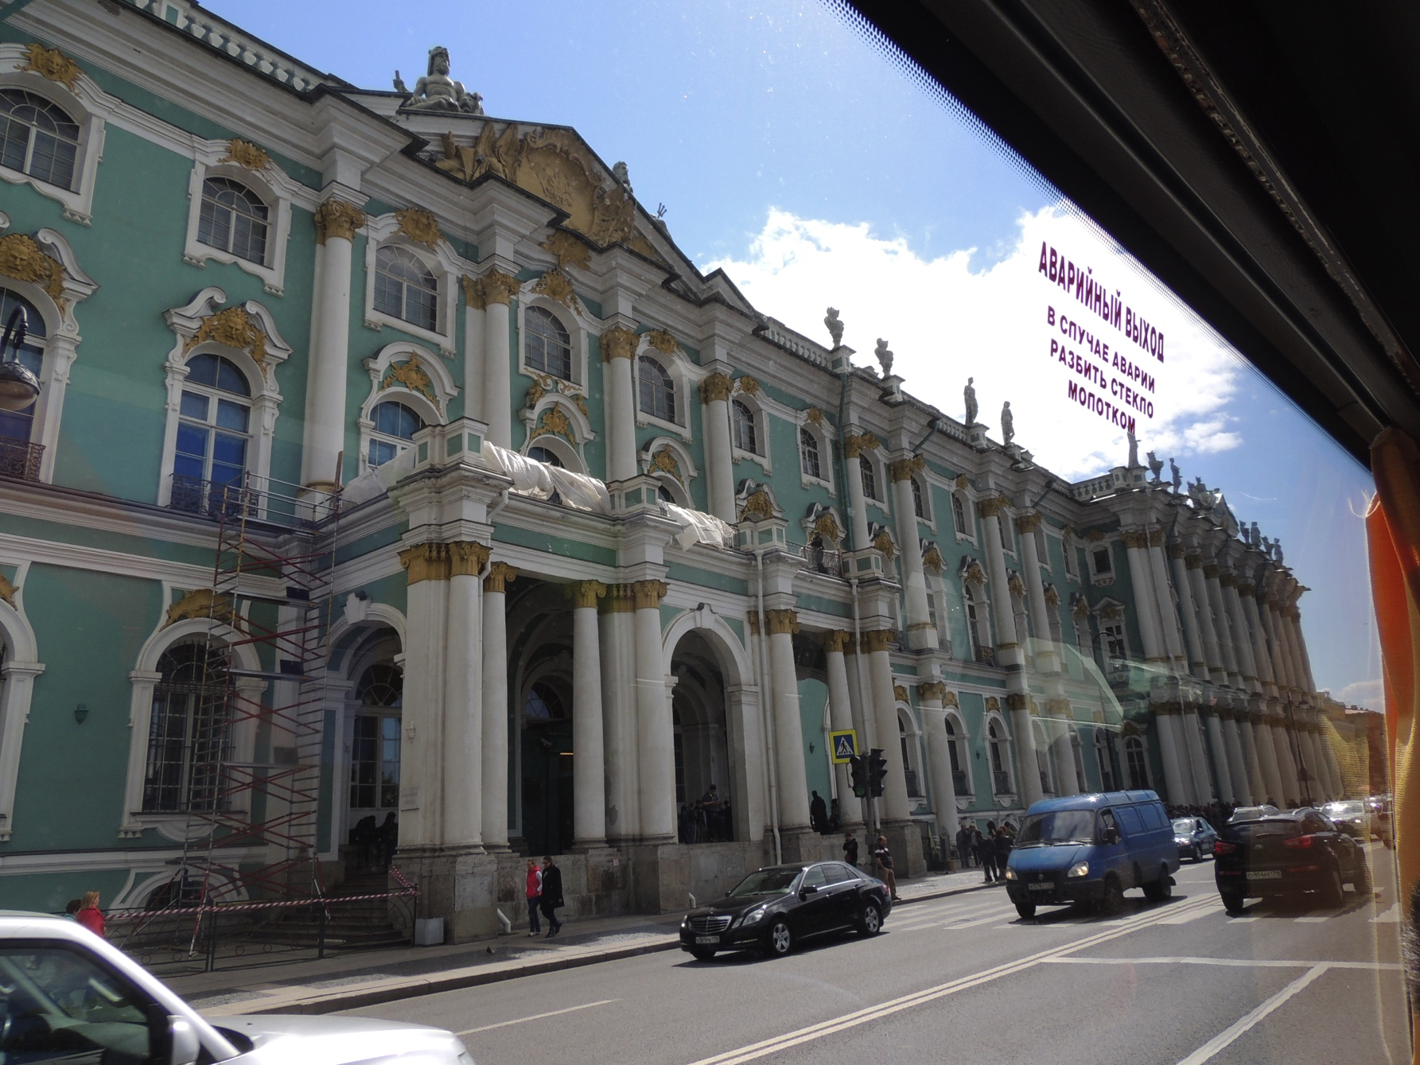

Slide 16
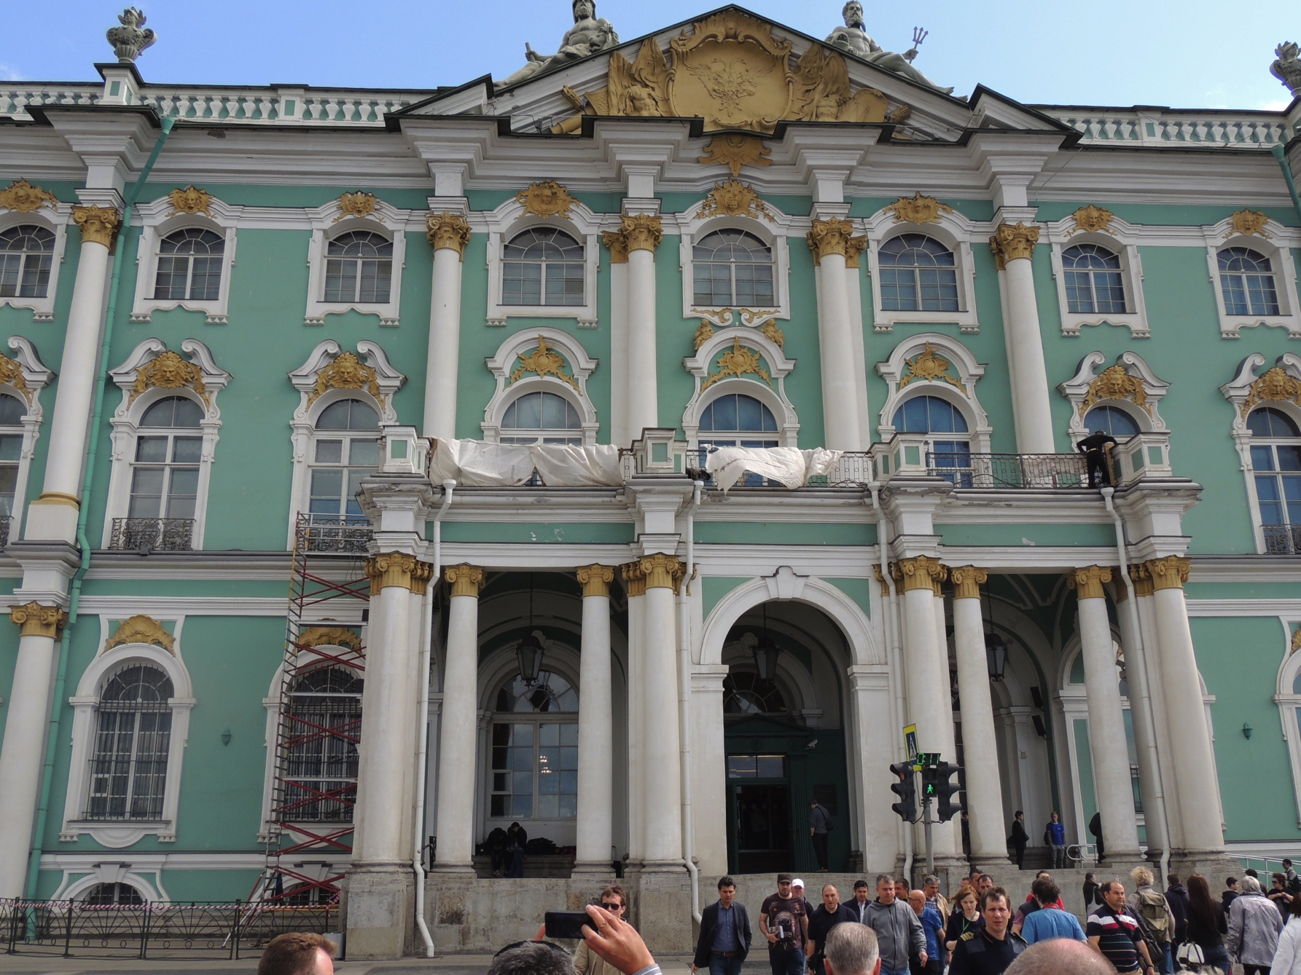

Slide 17
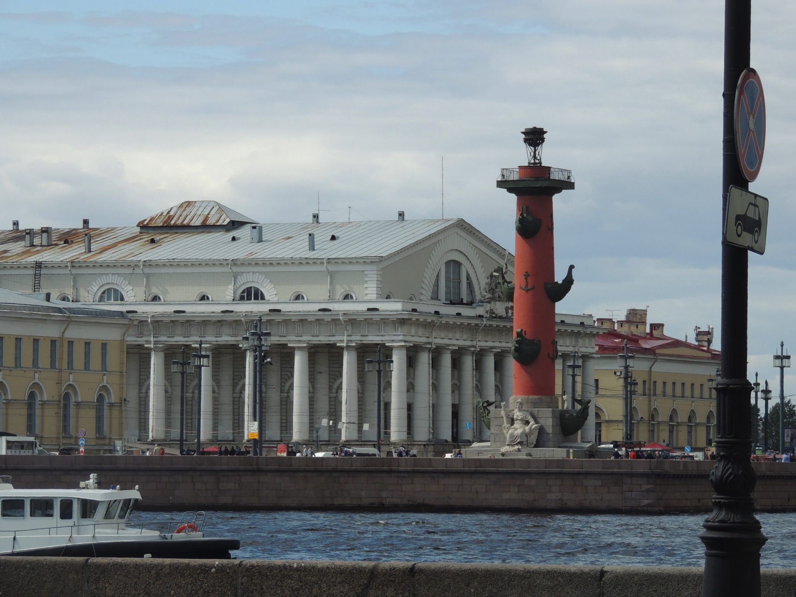

Slide 18
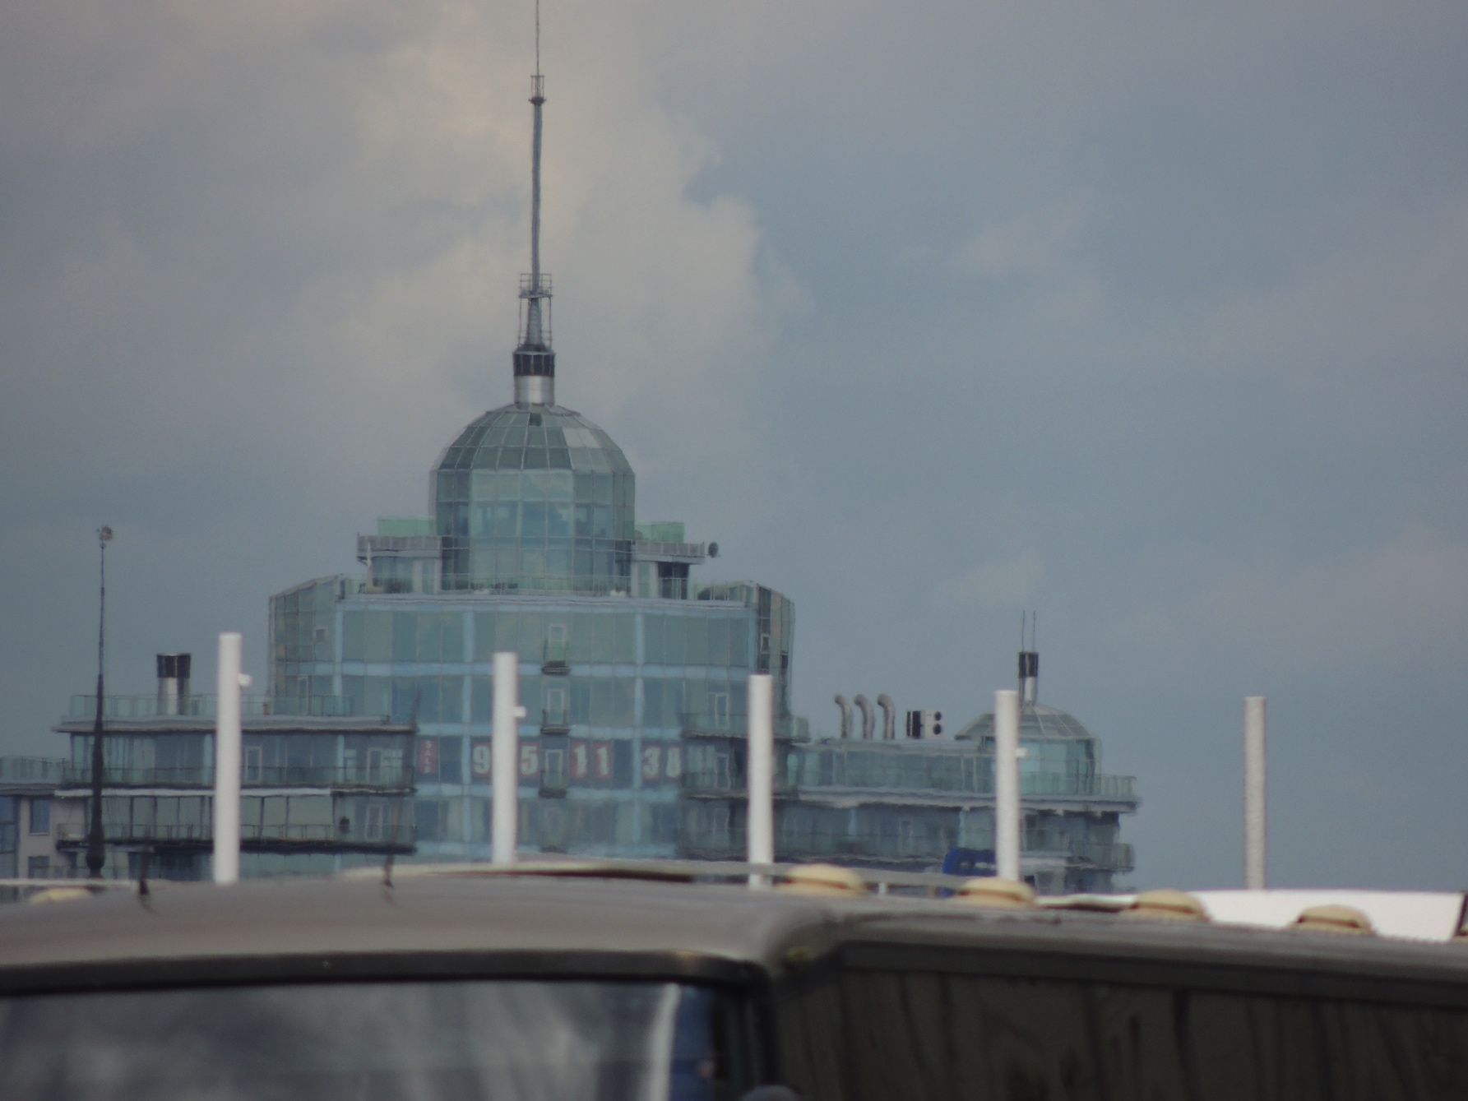

Slide 19
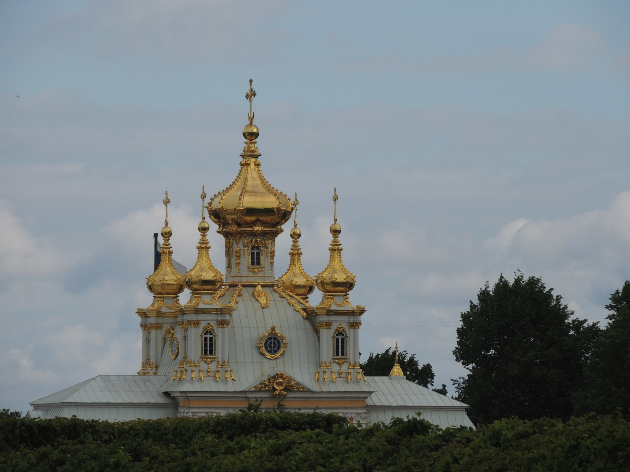

Slide 20
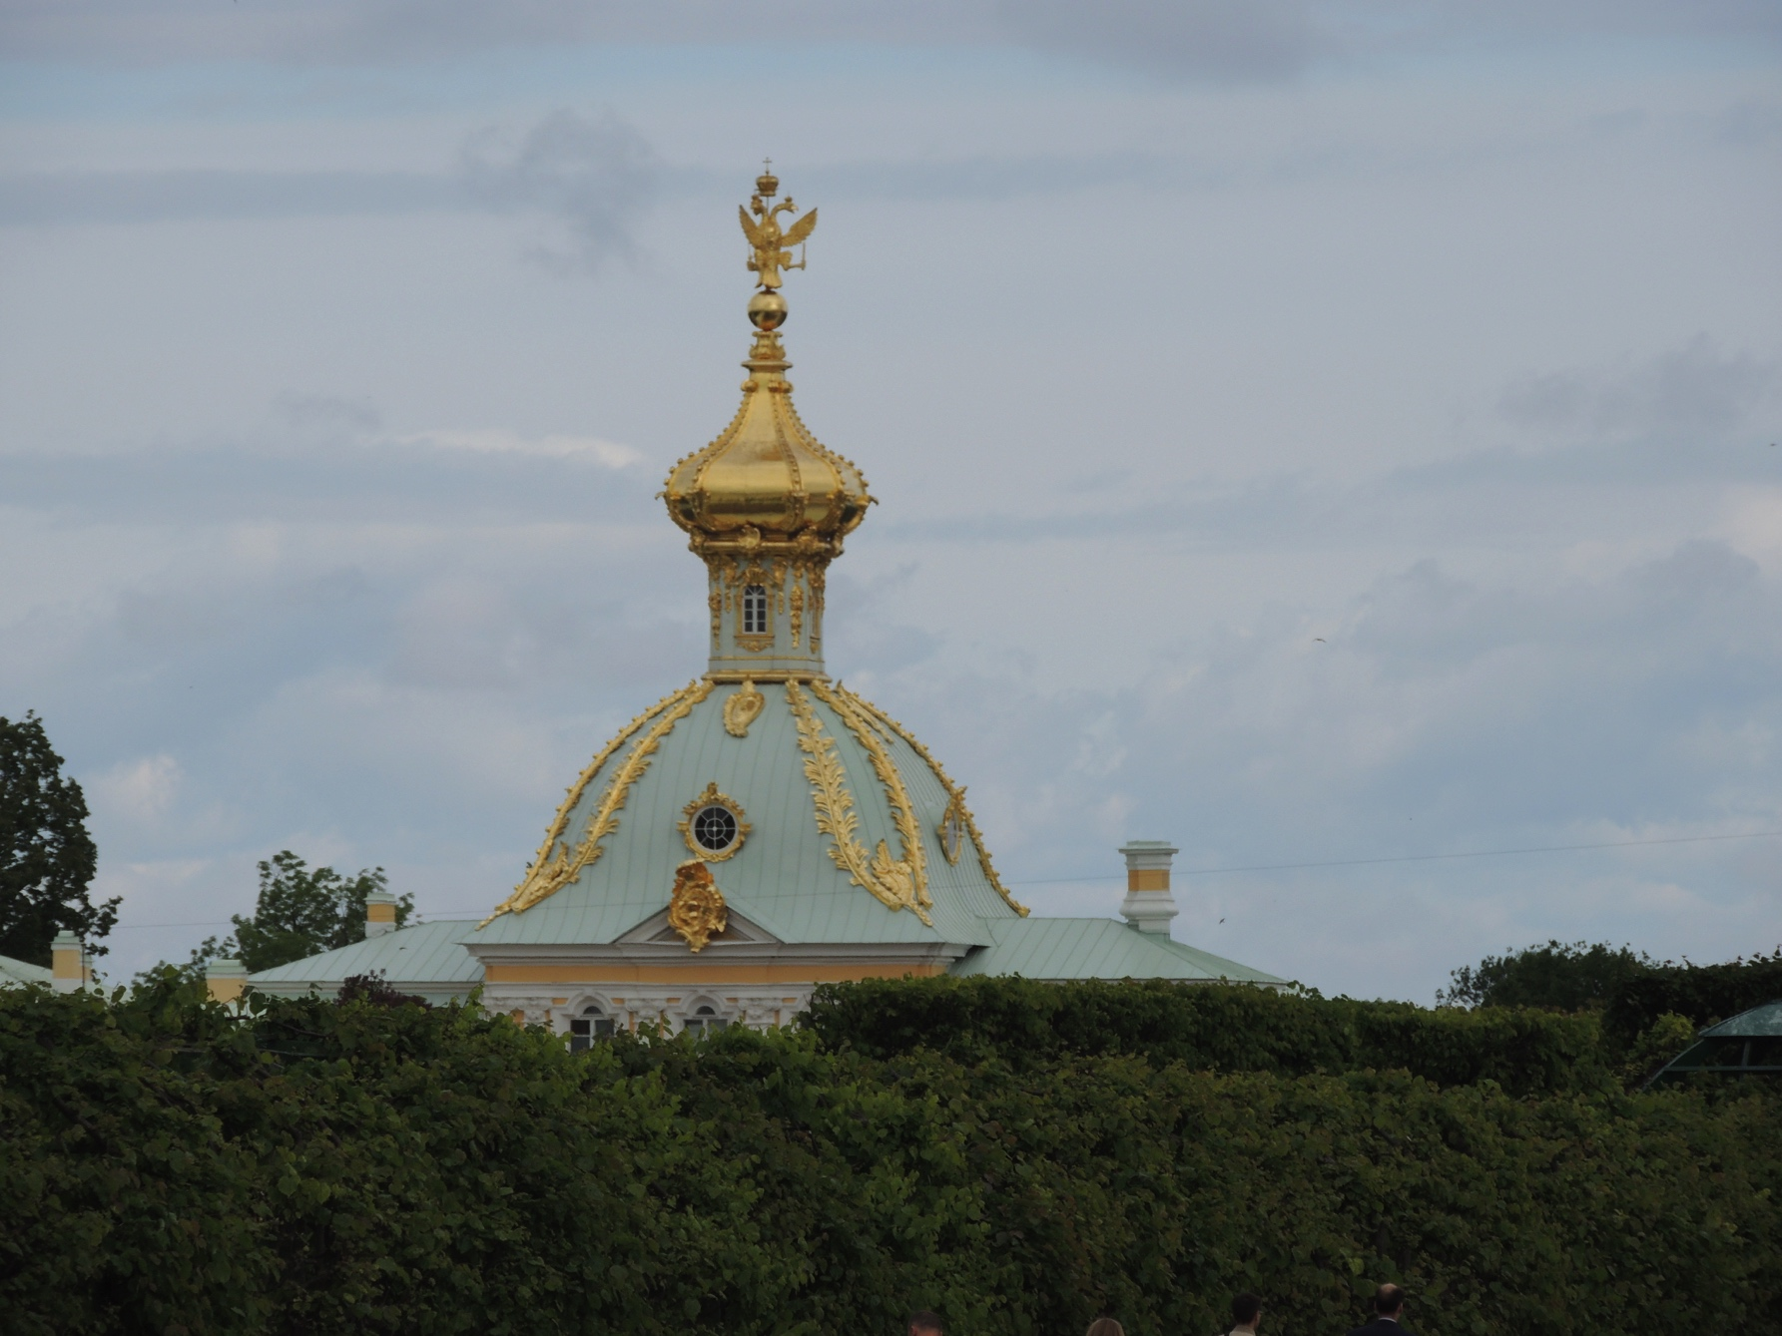

Slide 21
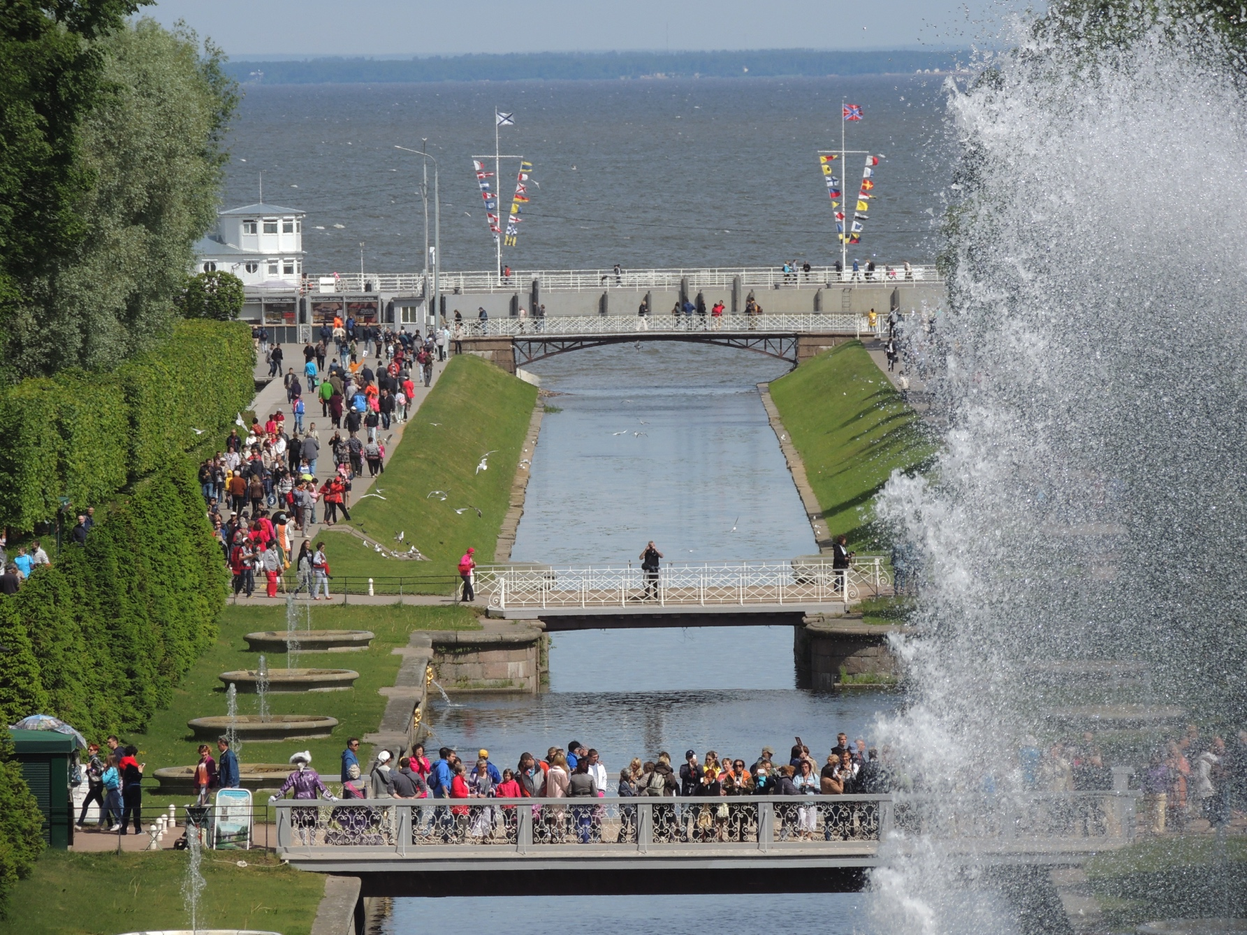

Slide 22
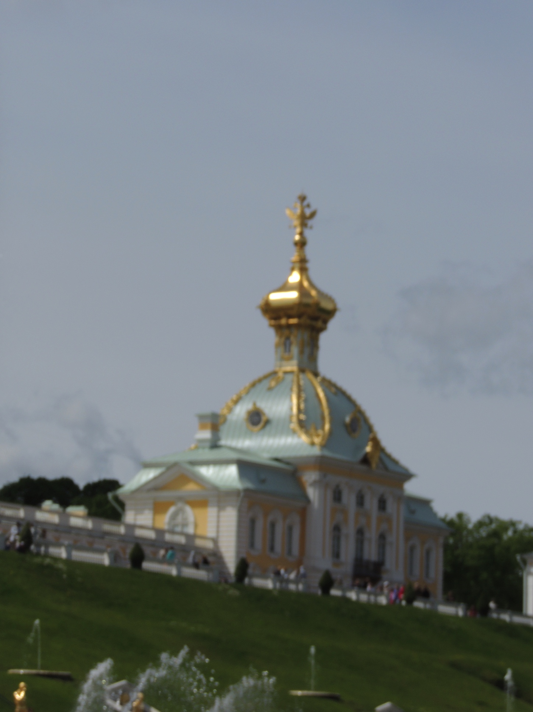

Slide 23
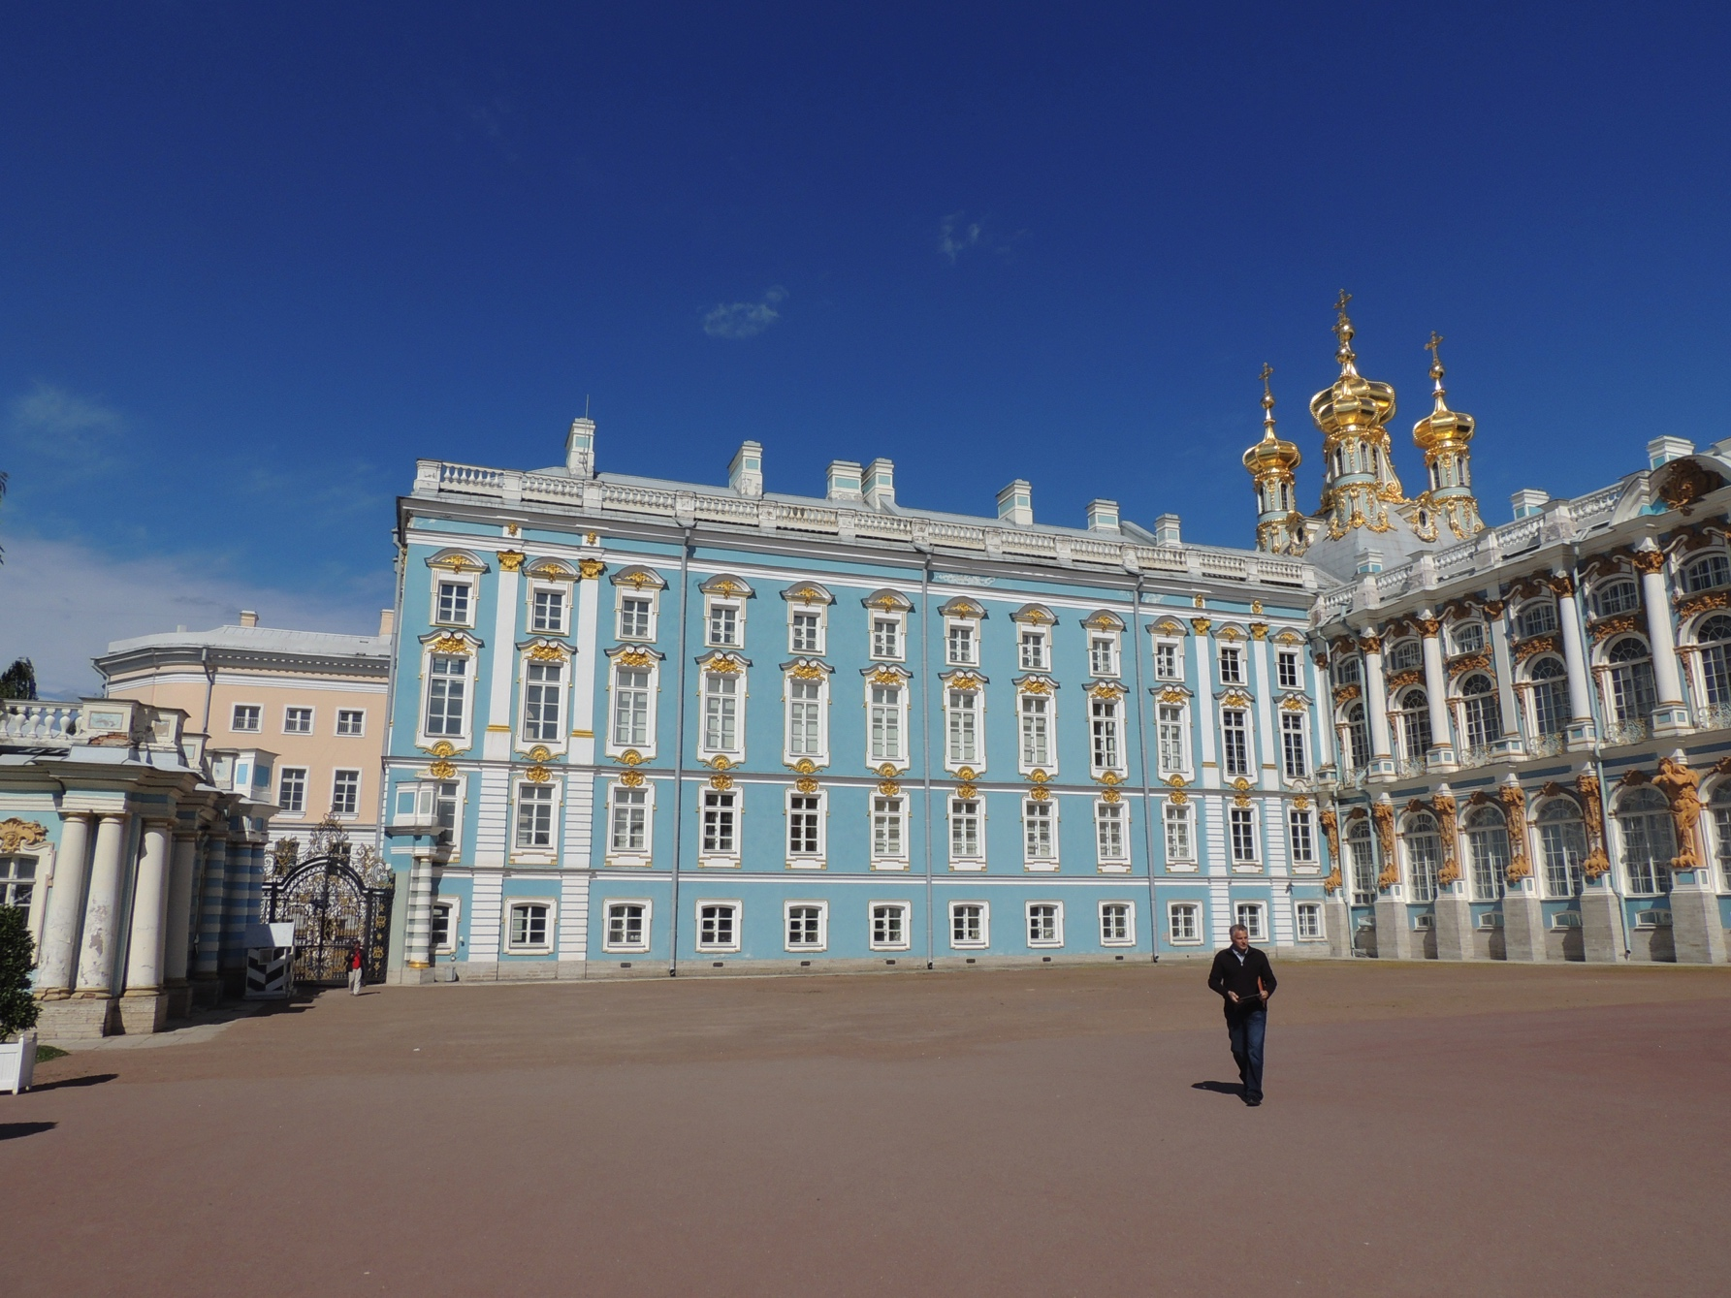

Slide 24
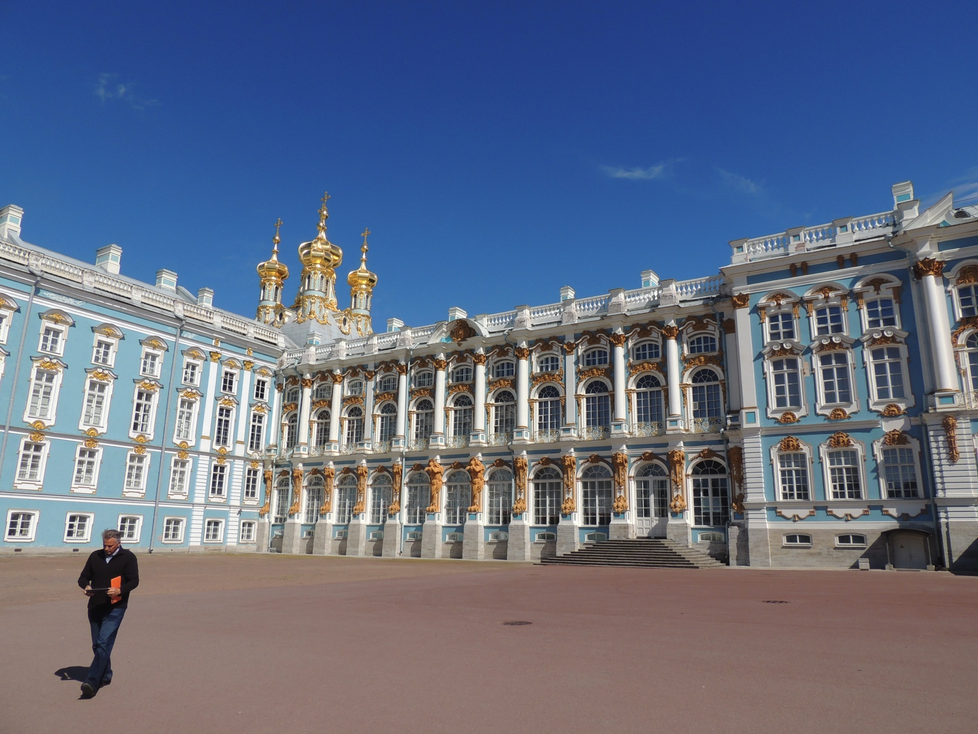

Slide 25
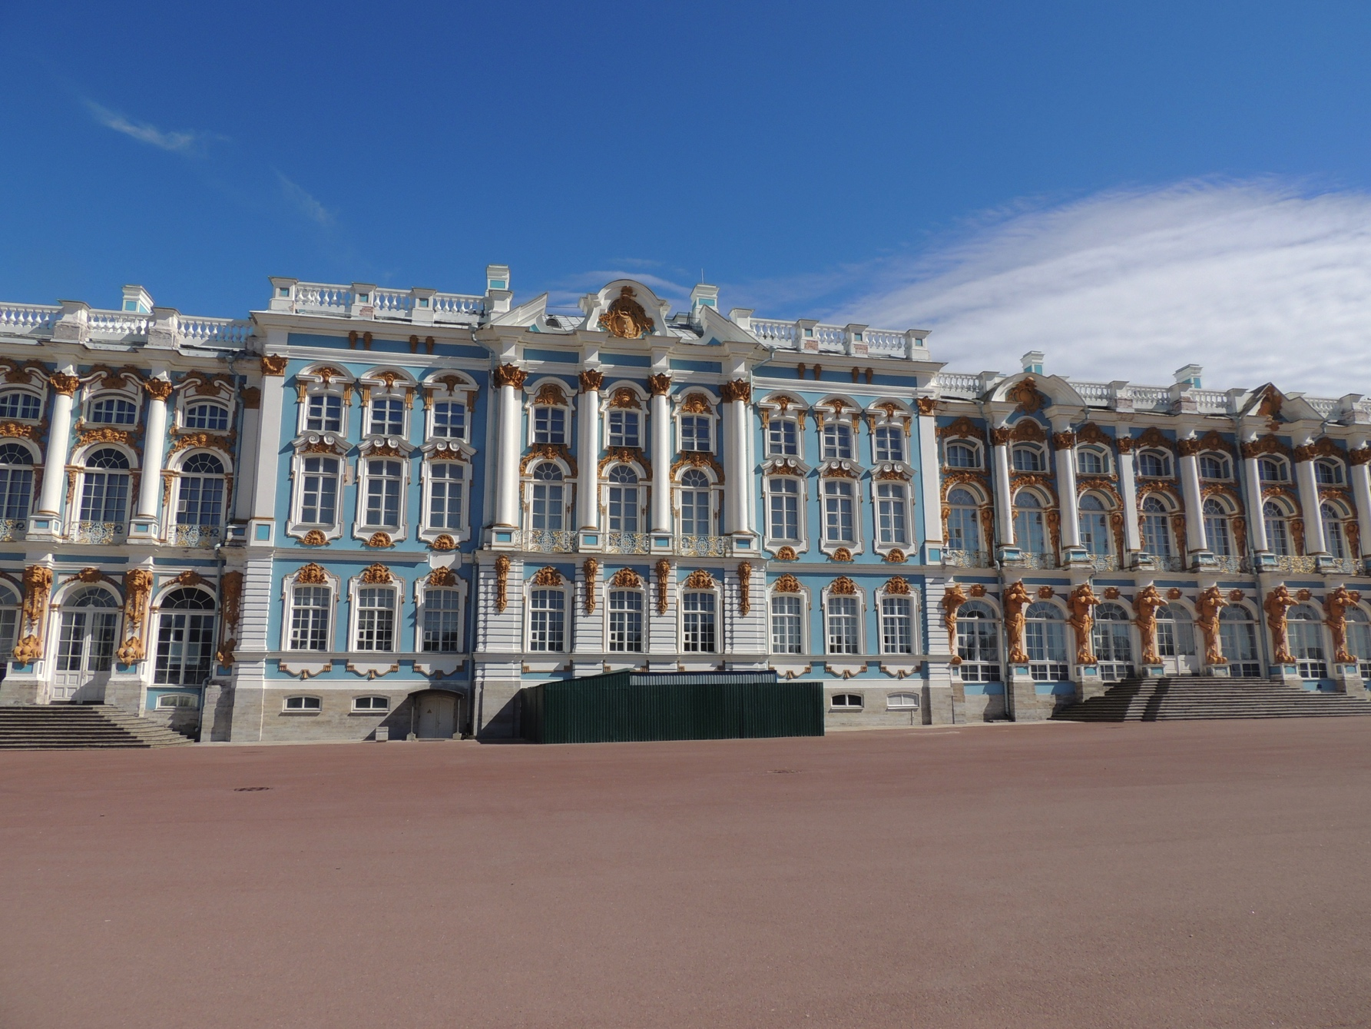

Slide 26
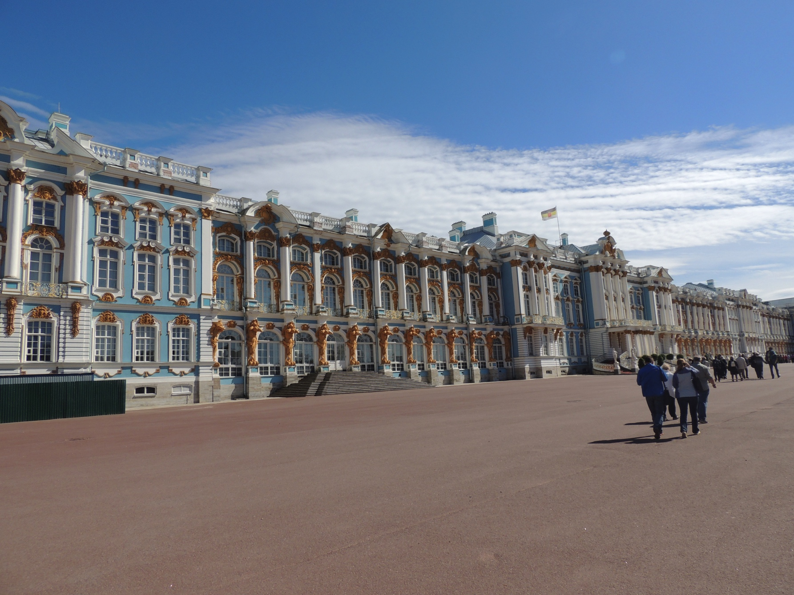

Slide 27
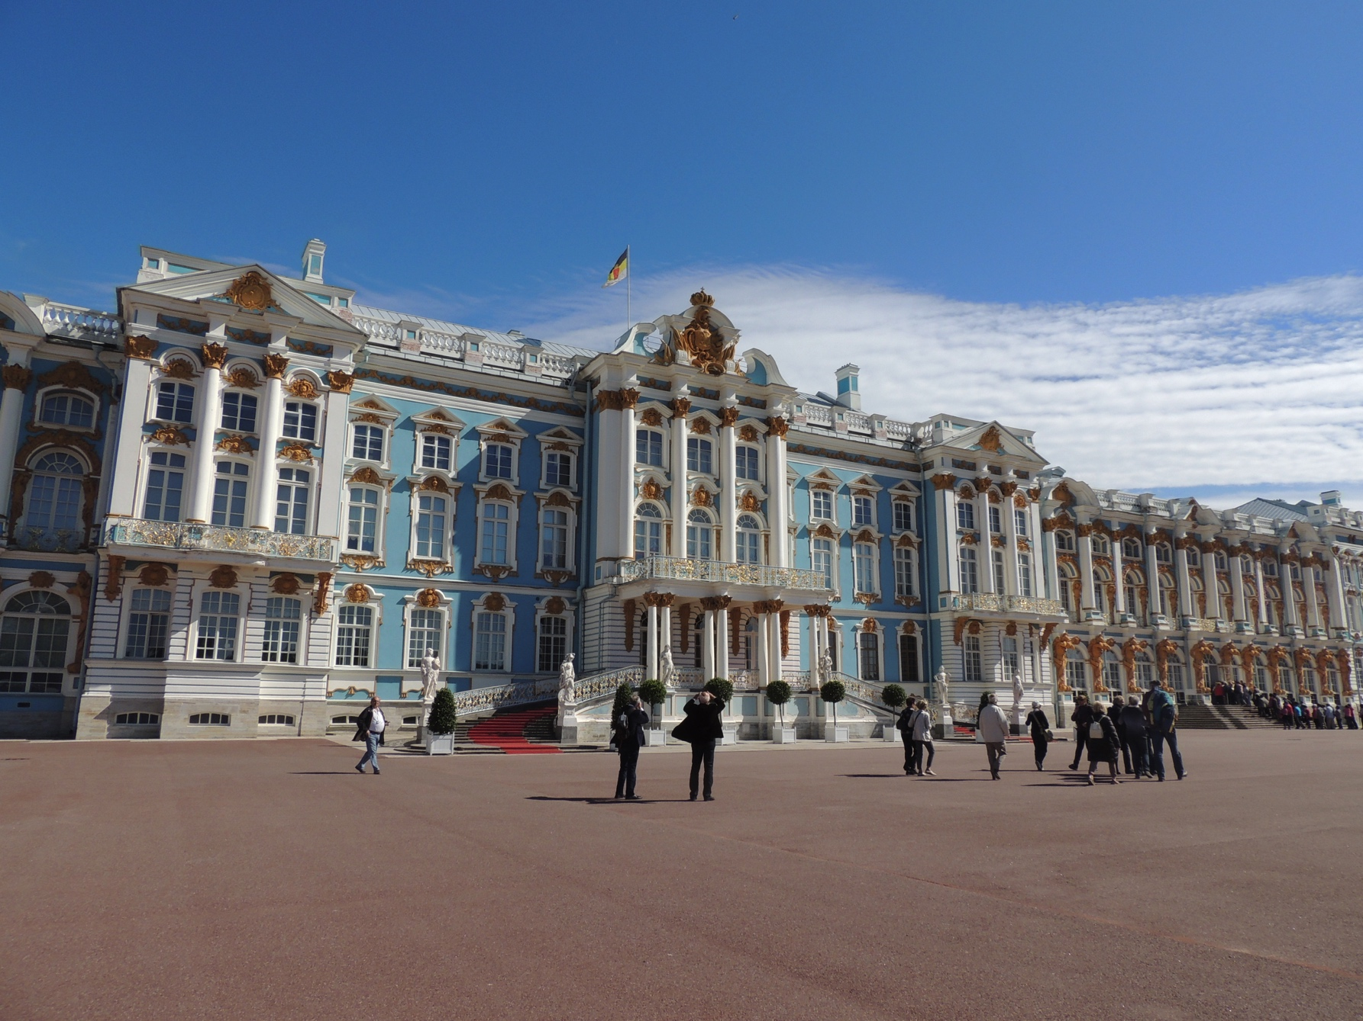

Slide 28
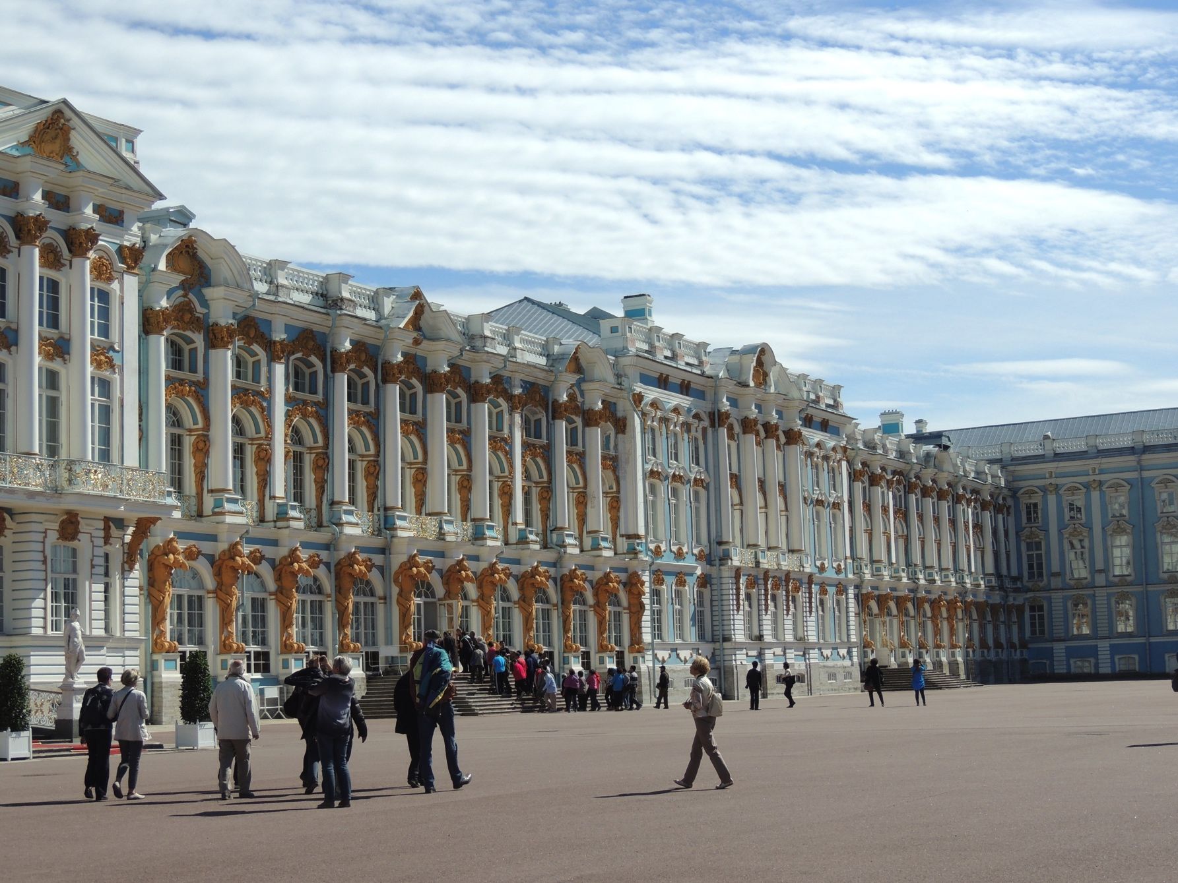

Slide 29
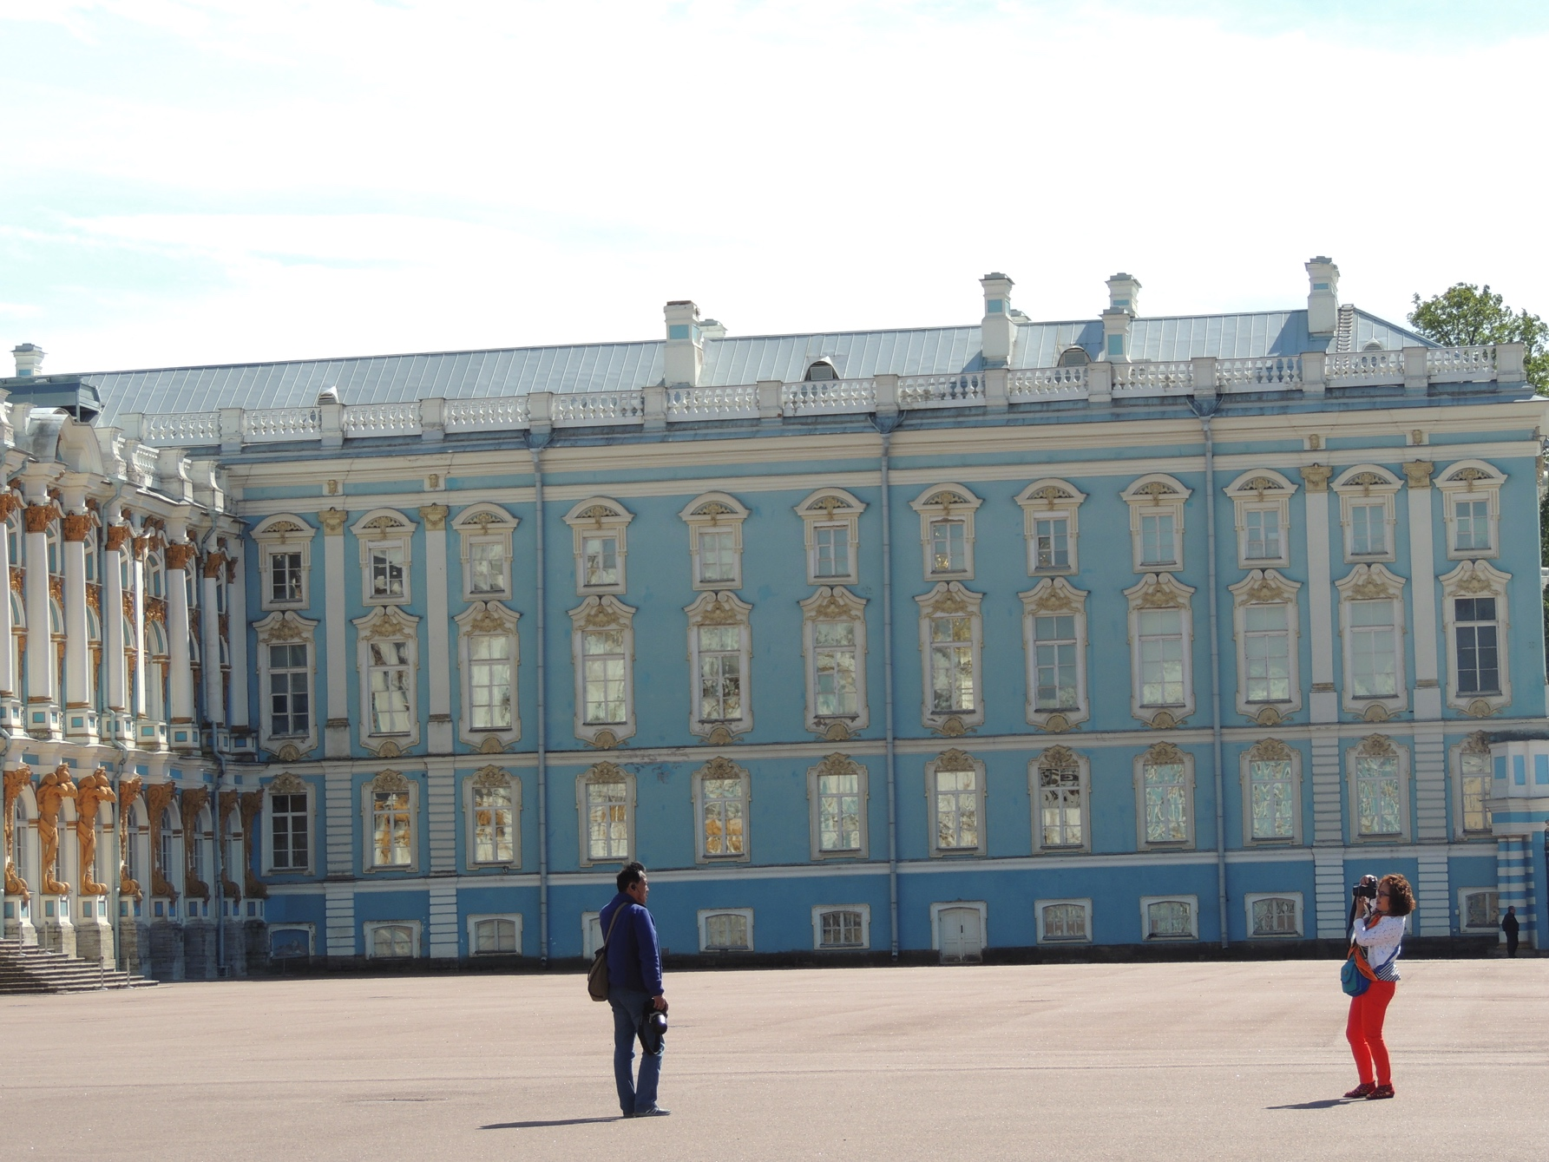

Slide 30
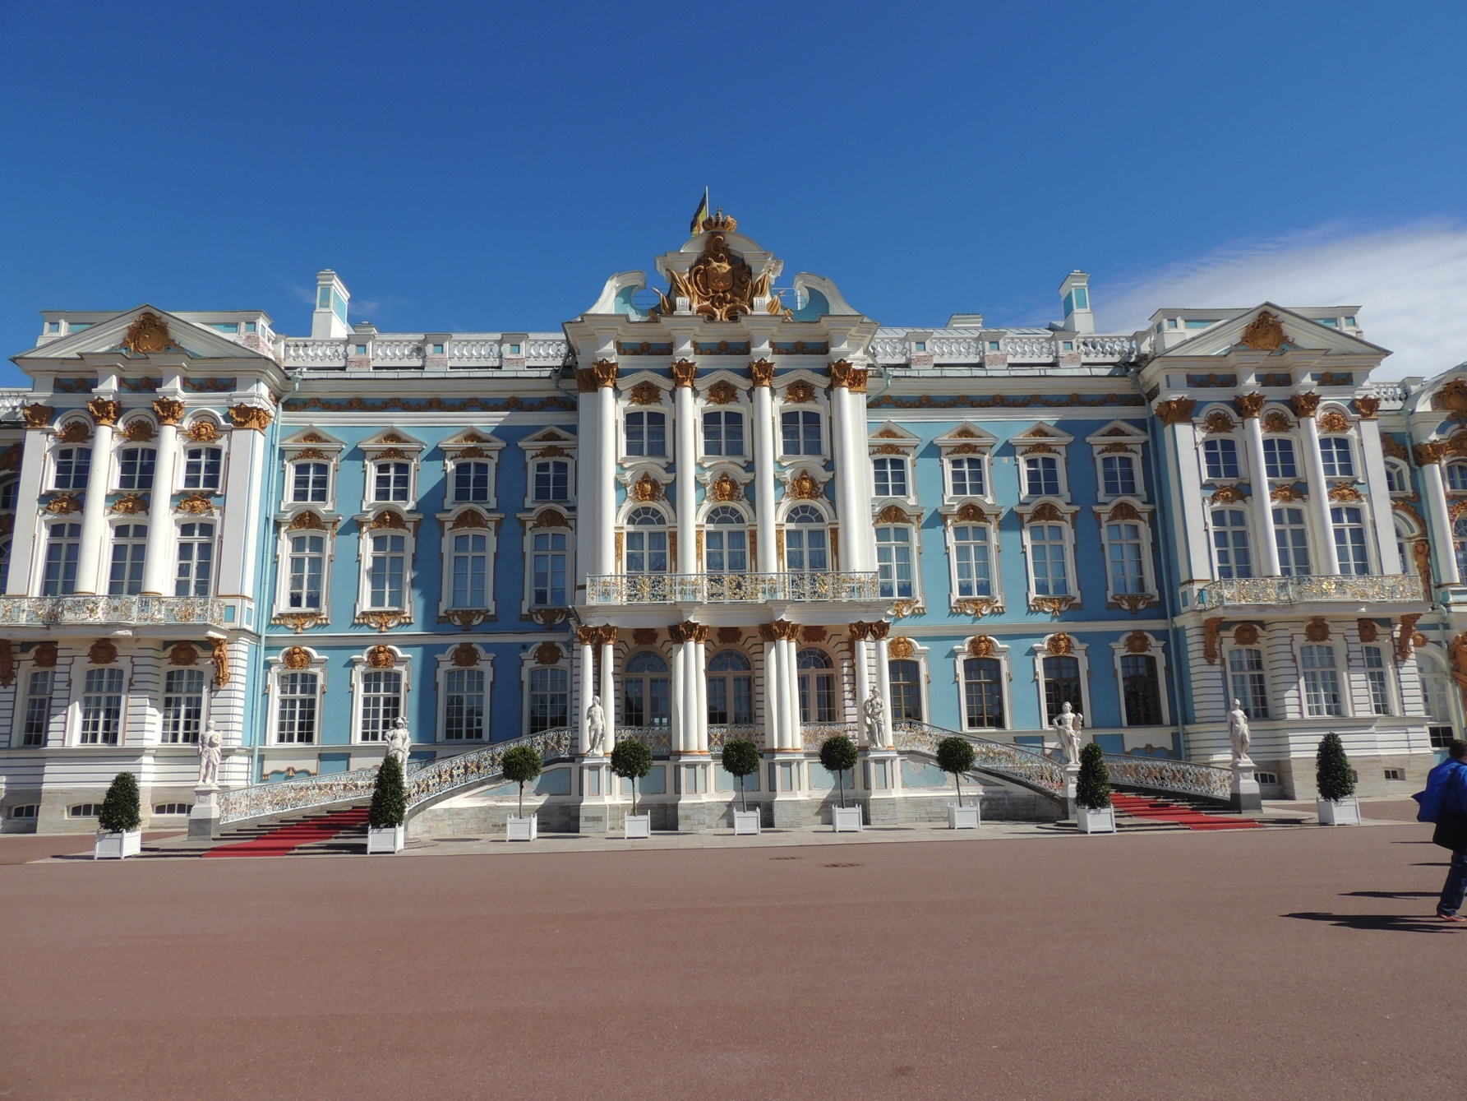

Slide 31
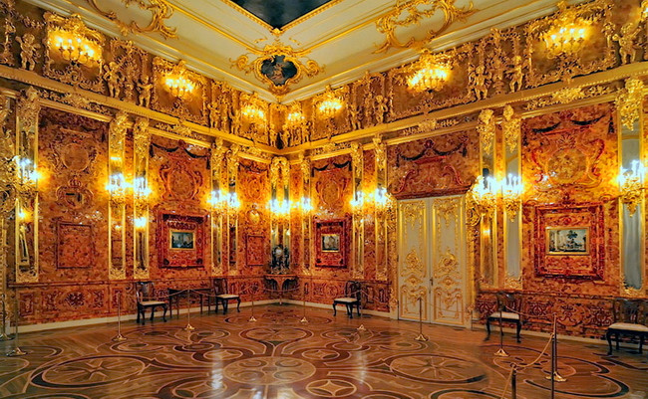

Slide 32
Discussion:
How did Labor change in America?
How did Labor change in Russia?
Did Labor improve either place?

