Slide 1
“When, in the course of development, class distinctions have disappeared and all production has been concentrated in the hands of a vast association of the whole nation, the public power will lose its political character. Political power, properly so called, is merely the organized power of one class for oppressing another. If the proletariat during its contest with the bourgeoisie is compelled, by the force of circumstances, to organize itself as a class, if, by means of a revolution, it makes itself the ruling class, and, as such, sweeps away by force the old conditions of production then it will, along with these conditions, have swept away the conditions for the existence of class antagonisms, and of classes generally, and will thereby have abolished its own supremacy as a class.
Karl Marx – The Communist Manifesto

Slide 2
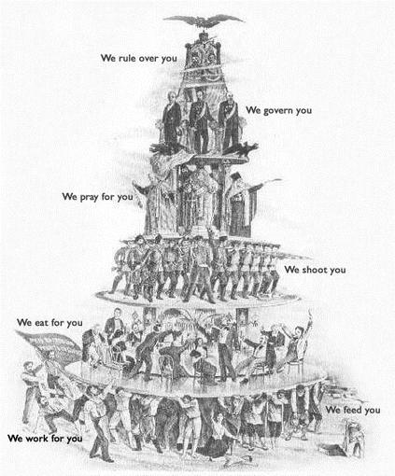
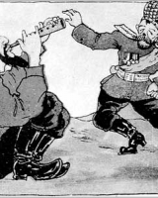
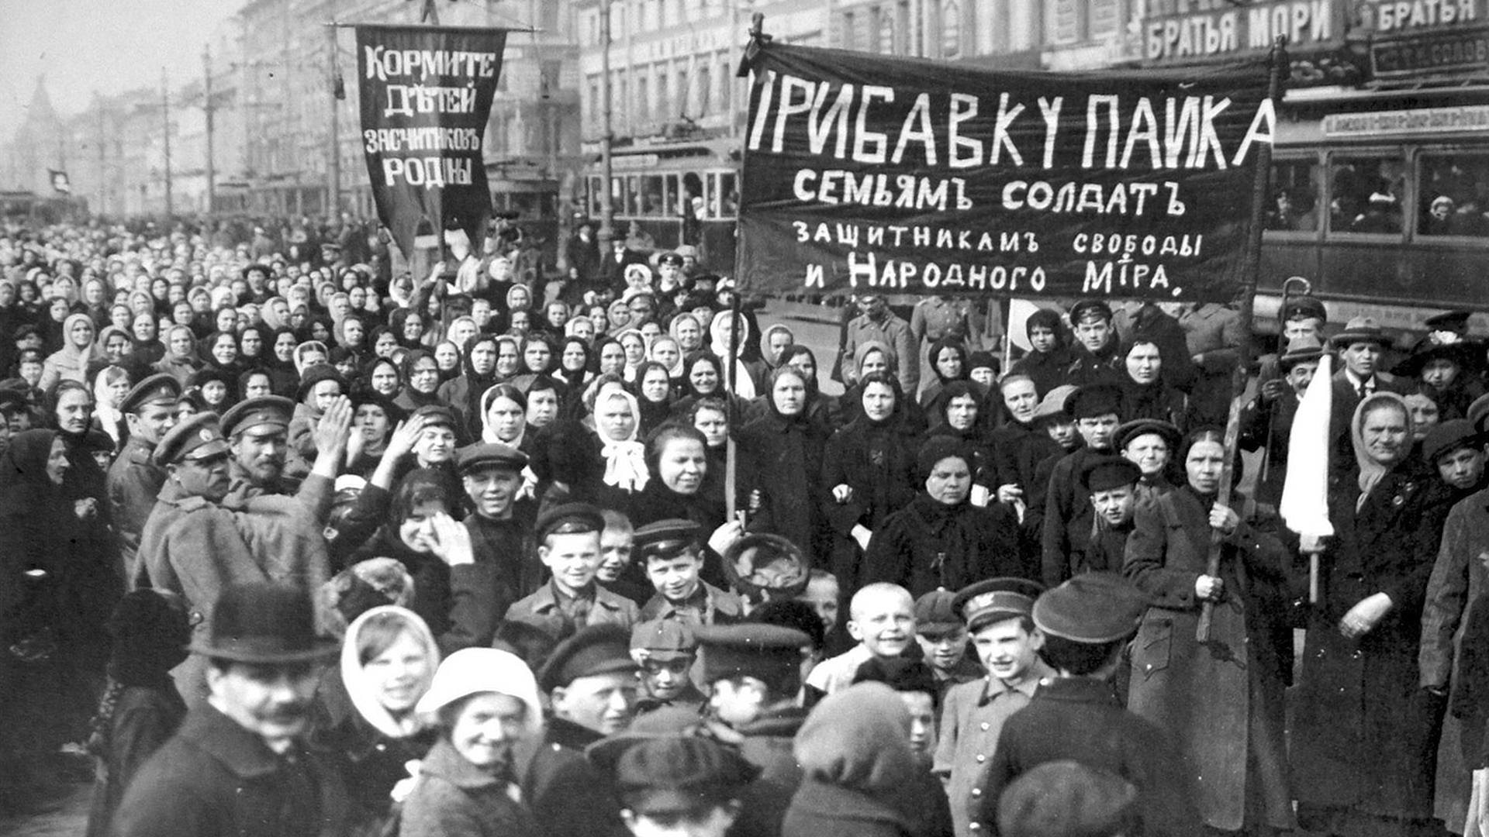

Slide 3
Websites to Use
    Seton Hall – Documents in Russian History – http://academic.shu.edu/russianhistory/index.php/Table_of_Contents
    Lenin Collected Works – https://www.marxists.org/archive/lenin/works/cw/index.htm#volume22
    Russian Revolution Documents – http://alphahistory.com/russianrevolution/russian-revolution-documents/
    Ohio State Russian Revolution Propaganda – https://ehistory.osu.edu/exhibitions/russian_revolution

Slide 4
Websites to Use
    Seton Hall – Documents in Russian History – http://academic.shu.edu/russianhistory/index.php/Table_of_Contents
    Lenin Collected Works – https://www.marxists.org/archive/lenin/works/cw/index.htm#volume22
    Russian Revolution Documents – http://alphahistory.com/russianrevolution/russian-revolution-documents/
    Ohio State Russian Revolution Propaganda – https://ehistory.osu.edu/exhibitions/russian_revolution

