Slide 1
World War I Through The Sources
Saturday, January 26, 2019
Oklahoma History Center - Oklahoma City, OK

Slide 2
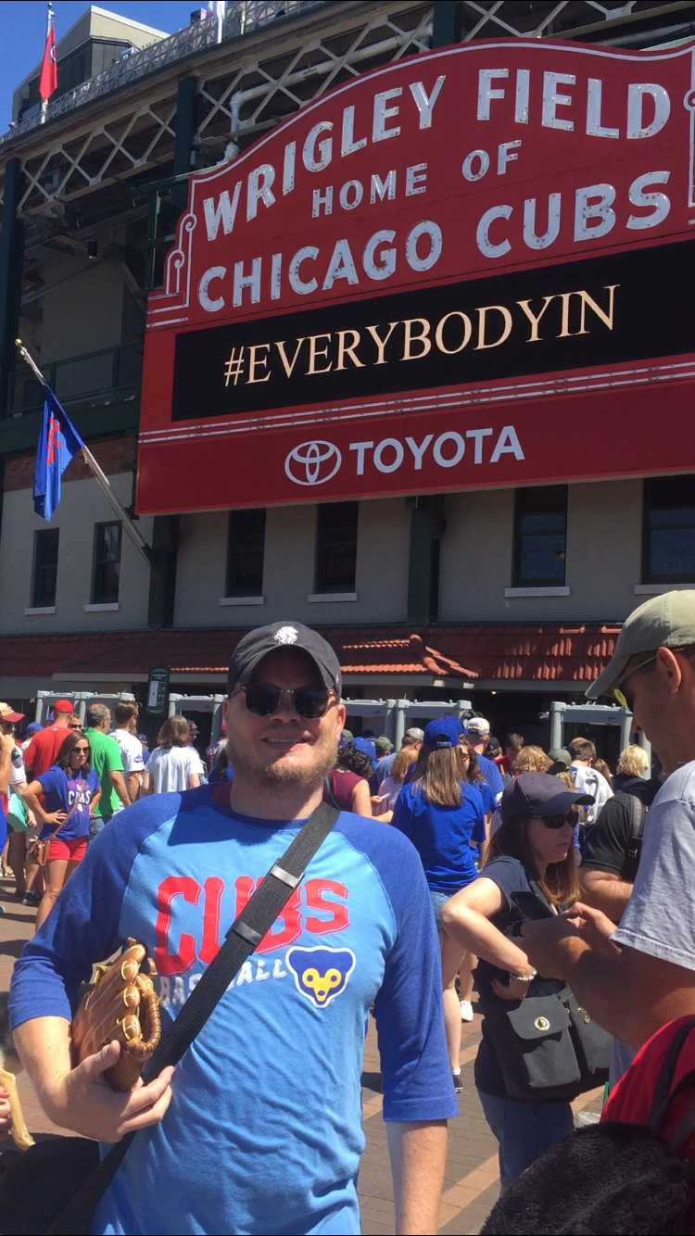
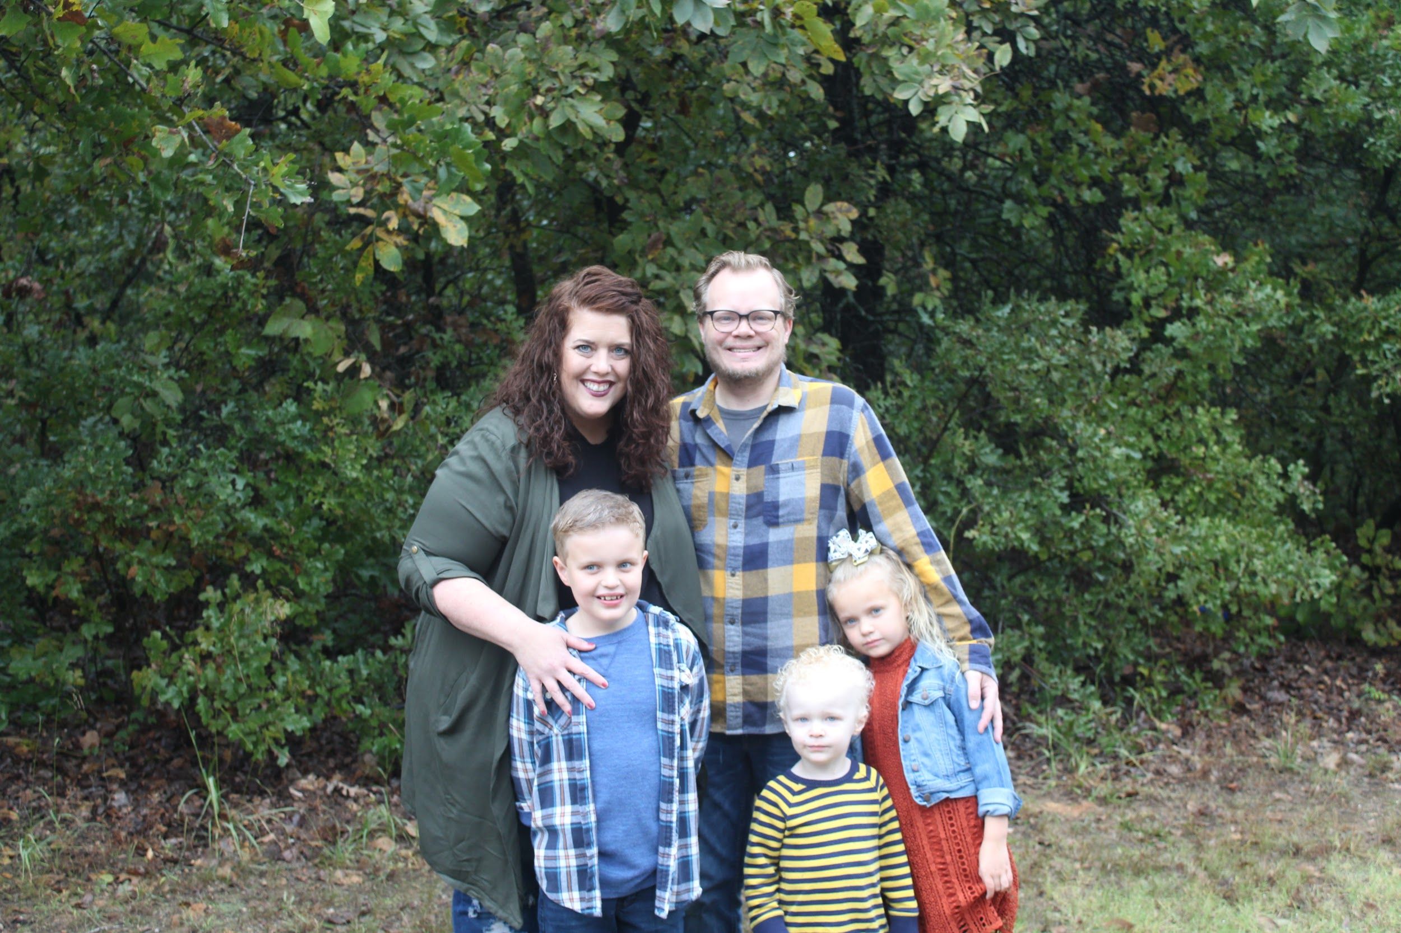
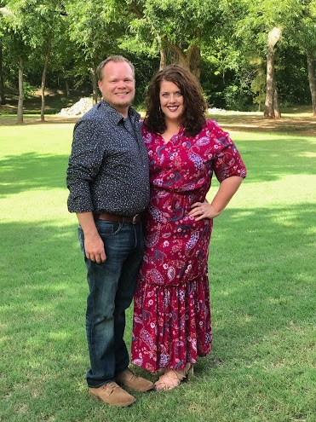
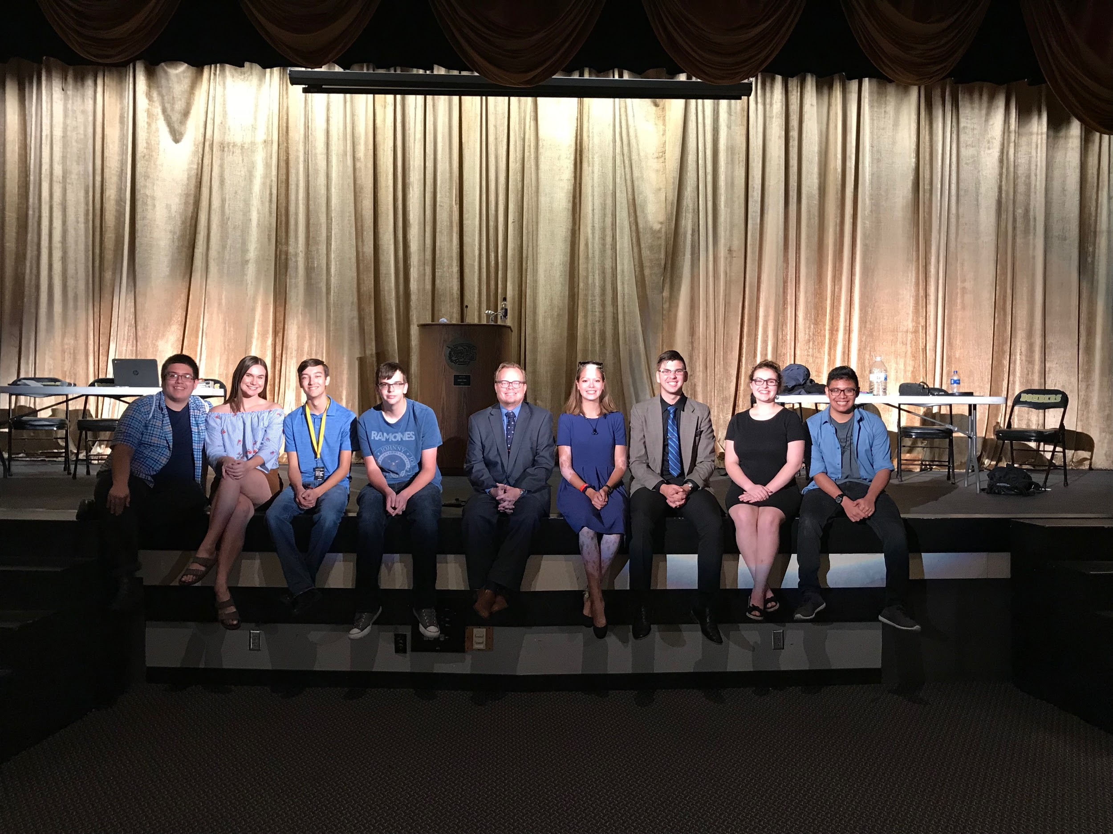
Who, What, Where, & Why?
Mr. Matthew Todd Gragg
Educator - Midwest City High School
  AP U.S. History
  AP Macroeconomics
  World History
  AP World History
  U.S. History
  Personal Financial Literacy
Board Member - OCSS
Member - EEAC - Federal Reserve Bank
Master Teacher - OCEE
Member - Oklahoma Jump$tart

Slide 3


Who, What, Where, & Why?

Slide 4
Primary Sources
Chicago Defender
The Chicago Defender was founded in 1905 by Robert Sengstacke Abbott. Abbott published the first issue, a run of 300 copies, on May 6, 1905. The Defender began as a four-page weekly handbill filled with local news and reproductions of clippings from other newspapers. Abbott initially sold both subscriptions and advertising for the paper himself by going door-to-door throughout Chicago, Illinois.
The Defender grew with the migration north. By 1917 it became the first African American paper to reach a circulation of 100,000 copies and to achieve national circulation. By 1920 its circulation reached 230,000 copies per week. Throughout the years, the Defender had many notable columnists, including Walter White and Langston Hughes. It also published early works of poet Gwendolyn Brooks; the first African American to win a Pulitzer Prize in any category. As a result of the Defender’s success Robert Abbott became one of the first African American millionaires.

Slide 5
Primary Sources
The True Sons of Freedom Poster
This poster pays tribute to the contributions that African Americans made during World War I. It specifically references the success of the 369th Infantry Regiment, known as the Harlem Hellfighters, an all-black unit from New York and the first Allied soldiers to engage the Germans. The poster honors to this accomplishment with the inscription “Colored Men—The First Americans Who Planted Our Flag on the Firing Line.” The unit served a total of 191 days in combat, more than any other company. Corporal Henry Johnson and Private Needham Roberts were the first Americans to receive the Croix de Guerre, awarded by the French in recognition of heroism during wartime. They were 2 of 171 members of the 369th Infantry to receive the award. The musicians in this unit, including James Reese Europe and Noble Sissle, were credited with introducing European audiences to jazz music. After being excluded from the regular parade of troops leaving New York City when they left for Europe, soldiers of the 369th Infantry were given a hero's welcome when they returned home on February 2, 1919. During the war, 200,000 African American served in combat, with a total of 380,000 serving in the overall war effort.

Slide 6
Primary Sources
The True Sons of Freedom Poster
This poster was one of several commissioned by the Committee on Public Information, under the direction of George Creel. Produced in 1919 by Charles Gustrine of Chicago, the poster shows African American soldiers attacking German soldiers, some of whom are surrendering. The combatants are engaged in a close combat, and the black soldiers are on the offensive, using their bayonets and sidearms. This may be in tribute to the heroic feats of Corporal Johnson and Private Roberts, who engaged the Germans in hand-to-hand combat after depleting their ammunition. In the background of the image hovers a watchful and serene Abraham Lincoln, with the inscription “Liberty and Freedom Shall Not Perish” along with his signature. The quote is a paraphrase of Lincoln's Gettysburg Address of 1863.
Ironically, despite the imagery of heroism on behalf of democracy, African Americans, both in the military and on the home front, experienced significant levels of discrimination. The United States military was segregated, which was consistent with Jim Crow policies that existed throughout the country. At the outset of the war, W. E. B. DuBois, a leading African American intellectual, encouraged blacks to “close ranks” and support the war effort, but African American soldiers returned home to the same discrimination they had faced before the war.

Slide 7
Primary Sources
Berthe Hunt Diary - The Hello Girls
Hello Girls was the colloquial name for American female switchboard operators in World War I, formally known as the Signal Corps Female Telephone Operators Unit. During World War I, these switchboard operators were sworn into the U.S. Army Signal Corps.
This corps were formed in 1917 from a call by General John J. Pershing to improve the worsening state of communications on the Western front. Applicants had to be bilingual in English and French to ensure that orders would be heard by anyone. Over 7,000 women applied, but only 450 women were accepted. Many of these women were former switchboard operators or employees at telecommunications companies. They completed their Signal Corps training at Camp Franklin, now a part of Fort George G. Meade in Maryland.
Berthe Hunt was such an operator during World War I that kept a diary for her husband in case he survived the War.

Slide 8
Primary Sources
C. Stanley Chapman
Chapman was the son of Valencia, Ca orange magnate Charles Chapman. The elder Chapman financially buffeted a struggling university that is now named after him - Chapman University. The various letters Stan wrote to his family during his service in World War I are kept in a collection at the university.
Save for this connection to an institute of higher education his letters might well be lost to the historical record. However, they do show something rather profound about the war and its impact on the lives of its participants.

Slide 9
Primary Sources
Charles Isum - (May 22, 1889–March 6, 1941)
Born in California. Worked as bookbinder for the Los Angeles Times. Drafted into army and was assigned to the medical detachment of the 1st Battalion, 365th Infantry Regiment, 92nd Division. In June 1918 his regiment arrived in France, where it held the St. Die sector of the Lorraine front, August–September. Regiment was kept in reserve during opening of the Meuse-Argonne offensive before being sent to Marbache Sector along the Moselle in October. Served in battalion aid station at Pont-à-Mousson under heavy artillery fire, November 5–10, before being sent to Lesménils, where he was gassed on the night before the Armistice. Threatened with court-martial in January 1919 for violating order forbidding black soldiers from speaking with French women, but charges were dropped, and Isum was honorably discharged in March 1919. Returned to Los Angeles and job at the Times. Married Zellee Jones. Retired from work in 1930s as heart condition linked to wartime gassing worsened. Daughter Rachel, born 1922, began studying nursing in 1940 at UCLA, where she met star athlete Jackie Robinson and introduced him to her father shortly before his death. (Rachel Isum and Jackie Robinson married in 1946, the year before he joined the Brooklyn Dodgers.)

Slide 10
Primary Sources
Ernest Hemingway
During the First World War, Ernest Hemingway volunteered to serve in Italy as an ambulance driver with the American Red Cross. In June 1918, while running a mobile canteen dispensing chocolate and cigarettes for soldiers, he was wounded by Austrian mortar fire. "Then there was a flash, as when a blast-furnace door is swung open, and a roar that started white and went red," he recalled in a letter home.
Despite his injuries, Hemingway carried a wounded Italian soldier to safety and was injured again by machine-gun fire. For his bravery, he received the Silver Medal of Valor from the Italian government—one of the first Americans so honored.

Slide 11
Primary Sources
Ernest Hemingway
Commenting on this experience years later in Men at War, Hemingway wrote: "When you go to war as a boy you have a great illusion of immortality. Other people get killed; not you. . . . Then when you are badly wounded the first time you lose that illusion and you know it can happen to you. After being severely wounded two weeks before my nineteenth birthday I had a bad time until I figured out that nothing could happen to me that had not happened to all men before me. Whatever I had to do men had always done. If they had done it then I could do it too and the best thing was not to worry about it."
Recuperating for six months in a Milan hospital, Hemingway fell in love with Agnes von Kurowsky, an American Red Cross nurse. At war's end, he returned to his home in Oak Park, Illinois, a different man. His experience of travel, combat, and love had broadened his outlook. Yet while his war experience had changed him dramatically, the town he returned to remained very much the same.

Slide 12
Standards
Oklahoma Social Studies Academic Standards – Process and Literacy Standard 2 (New Proposed standard 4)
The Student will develop and demonstrate Common Core social studies writing literacy skills. (Students will engage in critical, active reading of grade-level appropriate primary and secondary sources related to key social studies concepts, including frequent analysis and interpretation of informational sources)
Oklahoma Social Studies Academic Standards – World History Content Standard 4:4 (New Proposed standard 4:1)
Evaluate the forces of nationalism and militarism as well as the system of alliances as causes of World War I. (Explain the complex and multiple causes of World War I, including militarism, nationalism, imperialism, systems of alliances and other significant causes.)
Oklahoma Social Studies Academic Standards – United States History Content Standard 2:3 (New Proposed standard 3:2)
Evaluate the long-term impact of America’s entry into World War I on national politics, the economy, and society.

Slide 13
Objectives
Examine the main idea of a primary source.
Place a source document within its proper context.
Identify the various ways in which the Great War affected differing groups of Americans.
Explain the impact of World War I on an individual level.

Slide 14
Discussion
How is World War I typically taught?
Does this capture the variety of experience of Americans in the war?
Did various groups of American participants in World War I experience the way the same?
How can we teach this aspect of the war?

Slide 15
Activity
Get into 4 groups and each will examine one document and fill out the graphic organizer for that document.

Slide 16
Discussion
How is the experience of C. Stanley Chapman different from the press clippings sent by his father Charles?
How has the war changed Hemingway?
How are Isum’s interactions with the French different from those with his fellow Caucasian troops?
How is Hunt’s experiences different from what the three men see and do?
Are Hunt, Hemingway, Isum, and Chapman all fighting on the same side and for the same flag?
Why, if on the same team, are their experiences so different?
What is the “real” experience of the war or is this an impossible question?

Slide 17
Exit Ticket
Which group of soldiers faced the harshest conditions while overseas?
Which group of soldiers faced the easiest conditions?
Why were the experiences so widely different?

Slide 18
Questions?

Slide 19
Break

Slide 20
Sources Available from the Oklahoma History Center
Derek Donwerth
OkNHD Assistant

Slide 21
Break

Slide 22
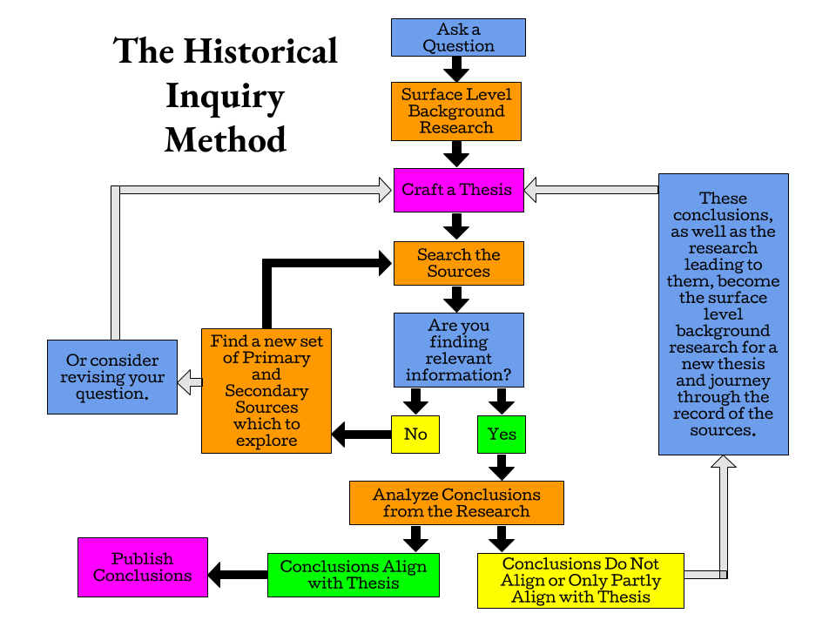

Slide 23
Where to find sources?

Slide 24
Activity
Group up by schools or subject/grade level.
Work through the sheet provided and create your own primary source based lesson.

Slide 25
Questions?

Slide 26
Survey
https://docs.google.com/forms/d/e/1FAIpQLSdRodxNWhrRM01aoFChuRjJXm4Lu2S_wNWPxmj8Vg8gLXLlAA/viewform?usp=sf_link

Slide 27
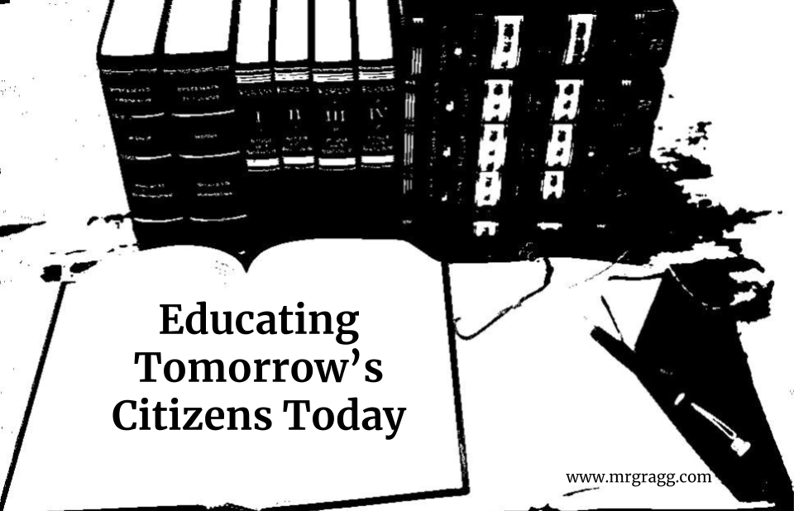
Ending Information
Where to find information:
www.mrgragg.com
Other topics available for presentations:
The Historical Inquiry Method
Abraham Lincoln and his impact on the Constitution.
The Gilded Age and Progressive Era
World War II
LBJ & The Civil Rights (Currently in development)

Slide 28
Survey
https://docs.google.com/forms/d/e/1FAIpQLSdRodxNWhrRM01aoFChuRjJXm4Lu2S_wNWPxmj8Vg8gLXLlAA/viewform?usp=sf_link

